Slide 1
Wireless Networks

Slide 2
Course Basics
Pre-requisite
Text books
Data Communication and Networks
Wireless Communication and Networks, 2nd Ed., W. Stalling.
Wireless Communications: Principles and Practices, 2nd Ed., T. S. Rappaport.
The Mobile Communications Handbook, J. D. Gibson

Slide 3
Objectives of Course
Introduce
Basics of wireless communication
Evolution of modern wireless communication systems
Wireless Networks
Research issues in emerging wireless networks
Outcomes
Adequate knowledge of wireless networks
Able to carry research in different domains of wireless networks

Slide 4
Course Syllabus
Introduction to wireless communication
Evolution of wireless communication systems
Medium access techniques
Propagation models
Cellular systems
AMPS, IS-95, IS-136, GSM,
Wireless networks
GPRS, EDGE, WCDMA, cdma2000, Mobile IP, WLAN and Bluetooth
Emerging networks
WiMAX, MANET, WSN

Slide 5
Introduction to Wireless Communication
The Wireless vision
Radio Waves
Channel Capacity
Signal-to-Noise Ratio
EM Spectrum

Slide 6
The Wireless vision
What is wireless communication?
What are the driving factors?
An explosive increase in demand of tetherless connectivity.
Dramatic progress in VLSI technology
Implementation of efficient signal processing algorithms.
New Coding techniques
Success of 2G wireless standards (GSM)
Notes:
What is wireless communication?
WC is one of the most vibrant areas of communication field today. While it has been a topic of study since 1960s but the last decade has seen a surge of research activities in this area. This is due to influence of several factors
First there has been an explosive increase in demand of tetherless connectivity, mainly by cellular telephony.
Second the dramatic progress in VLSI technology has enabled implementation of efficient signal processing algorithms and coding techniques
When two parties communicate without having any physical contact or medium of communication
There are several driving factors of its popularity.
People want connectivity anywhere anytime for example, at airports, hotels, customers place, or group of people wants to share data at any location. Such requirements have made the wireless connectivity indispensable.
Keep in mind that the course mainly focuses on wireless networks rather than communication techniques.

Slide 7
Wired Vs. Wireless Communication
Wired | Wireless
Each cable is a different channel
One media (cable) shared by all
Signal attenuation is low
High signal attenuation
No interference
High interference
noise; co-channel interference; adjacent channel interference

Slide 8
Why go wireless ?
Advantages
Sometimes it is impractical to lay cables
User mobility
Cost
Limitations
Bandwidth
Fidelity
Power
(In) security

Slide 9
Electromagnetic Signal
Function of time
Can also be expressed as a function of frequency
Signal consists of components of different frequencies
Notes:
EM signal is used as a means to transmit information. EM is a function of time but it can also be expressed as a function of frequency
That is the signal consists of components of frequencies. However, the frequency domain view of a signal is more important.

Slide 10
Time-Domain Concepts
Analog signal - signal intensity varies in a smooth fashion over time
No breaks or discontinuities in the signal
Digital signal - signal intensity maintains a constant level for some period of time and then changes to another constant level
Periodic signal - analog or digital signal pattern that repeats over time
s(t +T ) = s(t ) - ∞< t < + ∞
where T is the period of the signal
Aperiodic signal - analog or digital signal pattern that doesn't repeat over time
Notes:
In time domain, the signal can be either analog or digital.
In analog siganl, the signal intensity varies in a smooth fashion over time. For example in speech, voice changes its amplitude/intensity over time with continuous change.
Digital signals are binary 0s, 1s or text
Periodic signal: analog periodic signal like sine wave and digital periodic signal like square wave

Slide 11
Time-Domain Concepts
Peak amplitude (A) - maximum value or strength of the signal over time; typically measured in volts
Frequency (f )
Rate, in cycles per second, or Hertz (Hz) at which the signal repeats
Period (T ) - amount of time it takes for one repetition of the signal
T = 1/f
Phase (φ) - measure of the relative position in time within a single period of a signal
Notes:
General sine wave can be represented by three parameters

Slide 12
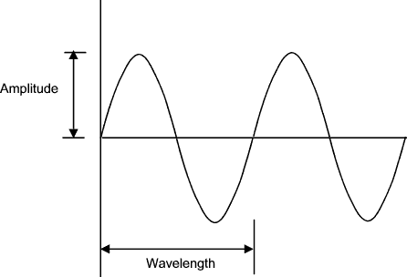
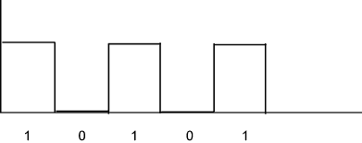
Time-Domain Concepts
Wavelength (λ) - distance occupied by a single cycle of the signal
Or, the distance between two points of corresponding phase of two consecutive cycles
λ = vT
Sine wave
Square wave

Slide 13
Time-Domain Concepts
General sine wave
s(t ) = A sin(2πft + φ)
Figure shows the effect of varying each of the three parameters
(a) A = 1, f = 1 Hz, φ = 0; thus T = 1s
(b) Reduced peak amplitude; A=0.5
(c) Increased frequency; f = 2, thus T = ½
(d) Phase shift; φ = π/4 radians (45 degrees)
note: 2π radians = 360° = 1 period

Slide 14
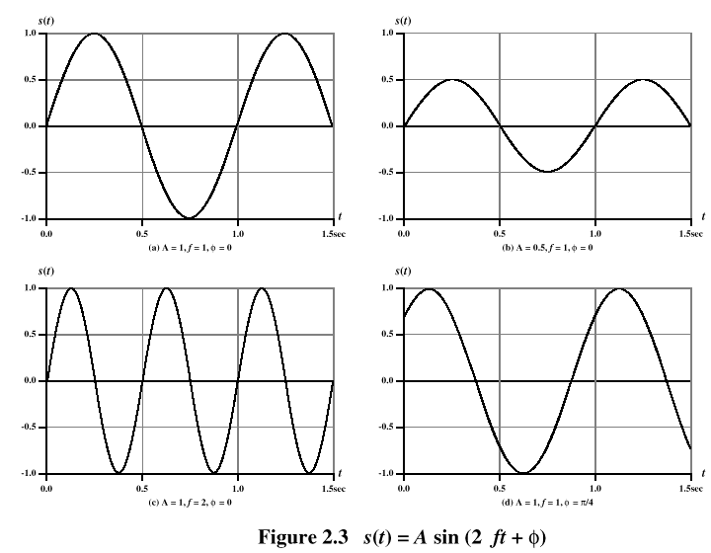
Sine Wave Parameters

Slide 15
Frequency-Domain Concepts
Fundamental frequency - when all frequency components of a signal are integer multiples of one frequency, it’s referred to as the fundamental frequency
Spectrum - range of frequencies that a signal contains
Absolute bandwidth - width of the spectrum of a signal
Effective bandwidth (or just bandwidth) - narrow band of frequencies that most of the signal’s energy is contained in

Slide 16
Frequency-Domain Concepts
Any electromagnetic signal can be shown to consist of a collection of periodic analog signals (sine waves) at different amplitudes, frequencies, and phases
The period of the total signal is equal to the period of the fundamental frequency

Slide 17
Relationship between Data Rate and Bandwidth
The greater the bandwidth, the higher the information-carrying capacity
Conclusions
Any digital waveform will have infinite bandwidth
BUT the transmission system will limit the bandwidth that can be transmitted
AND, for any given medium, the greater the bandwidth transmitted, the greater the cost
HOWEVER, limiting the bandwidth creates distortions

Slide 18
About Channel Capacity
Impairments, such as noise, limit data rate that can be achieved
For digital data, to what extent do impairments limit data rate?
Channel Capacity – the maximum rate at which data can be transmitted over a given communication path, or channel, under given conditions

Slide 19
Concepts Related to Channel Capacity
Data rate - rate at which data can be communicated (bps)
Noise - average level of noise over the communications path
Error rate - rate at which errors occur
Error = transmit 1 and receive 0; transmit 0 and receive 1

Slide 20
Nyquist Bandwidth
For binary signals (two voltage levels)
C = 2B
With multilevel signaling
C = 2B log₂ M
M = number of discrete signal or voltage levels
Notes:
Give an example for M = 8 and B 3100 C = 18600
So the data rate can be increased by increasing the number of different signal elements. This places an extra burden on receiver

Slide 21
Signal-to-Noise Ratio
Ratio of the power in a signal to the power contained in the noise that’s present at a particular point in the transmission
Typically measured at a receiver
Signal-to-noise ratio (SNR, or S/N)
A high SNR means a high-quality signal, lower number of required intermediate repeaters
SNR sets upper bound on achievable data rate
Notes:
SNR expresses the amount in decibels that the intended signal exceeds the noise level.

Slide 22
Shannon Capacity Formula
Equation:
Represents theoretical maximum that can be achieved
In practice, only much lower rates achieved
Formula assumes white noise (thermal noise)
Impulse noise is not accounted for
Attenuation distortion or delay distortion not accounted for
Notes:
Nyquist formula indicates that all other things being equal, doubling the bandwidth doubles the data rate
Shannon investigate relationship of data rate with bandwidth and noise.
From the Eq., data rate can be increased either by increasing bandwidth or signal strength.
LowerF = 3Mhz, UpperF = 4 MHz SNR = 24 then
B = 4 – 3 = 1 MHz
SNRdb = 10log10 (24) = 251
C = 10^6 x log2(1 + 251)
Approx. 10^6 x 8 bps = 8 Mbps
For this data rate, the number of signal levels by Nyquist formula are
M = 16

Slide 23
EM Spectrum
ISM band
902 – 928 Mhz
S/W radio
FM radio
TV
2.4 – 2.4835 Ghz
AM radio
TV
cellular
5.725 – 5.785 Ghz
LF
MF
HF
VHF
UHF
SHF
EHF
ν
30kHz
300kHz
3MHz
30MHz
300MHz
3GHz
30GHz
300GHz
10cm
100mm
λ
10km
1km
100m
10m
1m
1cm
X rays
ν
infrared
visible
UV
Gamma rays
1 kHz
1 MHz
1 GHz
1 THz
1 PHz
1 EHz
Propagation characteristics are different in each frequency band
Notes:
20 Hz to ~14 kHz, acoustic — normal range of adult human hearing (most children and some animals perceive sounds outside this range, most teens and children can hear frequencies from 14 kHz up to ~16 kHz where most adults can't)
530 kHz to 1.710 MHz, electromagnetic — AM radio broadcasts
42 MHz to 260 MHz, electromagnetic — VHF terrestrial TV broadcast channels
88 MHz to 108 MHz, electromagnetic — FM radio broadcasts
902 MHz to 928 MHz, common cordless telephone frequency in the US
0.8 to 2.3 GHz, (electromagnetic) - mobile phone conversation channels.
2.4 GHz, (electromagnetic) - microwave ovens, Wireless LANs and cordless phones (starting in 1998).
5.8 GHz, cordless phone frequency introduced in 2003
428 THz to 750 THz, electromagnetic — visible light, from red to violet
30 Petahertz (PHz), electromagnetic — x-rays
300 Exahertz (EHz) and above - gamma rays

Slide 24
Design Challenges
Two fundamental aspects of wireless communication
Channel fading
Multipath fading
Path loss via distance attenuation
Shadowing by obstacles
Interference
Multiple transmitters to a common receiver
Multiple transmitters to multiple receivers
Notes:
In wireless telecommunications, multipath is the propagation phenomenon that results in radio signals' reaching the receiving antenna by two or more paths. Causes of multipath include atmospheric ducting, ionospheric reflection and refraction, and reflection from terrestrial objects, such as mountains and buildings.

Slide 25
The primary concern in wireless systems is to increase the reliability of air interface.
This is achieved by controlling the channel fading and interference.
Recently the focus has shifted to spectral efficiency.

Slide 26
Summary
EM seen in domain of time and frequency
Analog and digital signal
Periodic and aperiodic signal
Frequency, amplitude and wavelength of signal
Fundamental frequency
Channel capacity
Nyquist formula
Shannon formula
EM Spectrum
Design challenges in wireless communication

